Slide 1
NICHES AND COMMUNITY INTERACTIONS

Slide 2
ECOSYSTEM =COMMUNITY + ABIOTIC FACTORS
Stable Ecosystems
population numbers of each organism fluctuate at a predictable rate
supply of resources fluctuates at predictable rate
energy flows through ecosystem at constant rate
**Organisms constantly interact which generates stability**

Slide 3
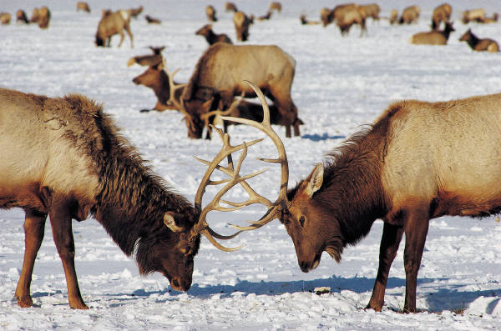
The Niche
What is a niche?
An organism’s niche describes not only the environment where it lives, but how it interacts with biotic and abiotic factors in the environment.
*an organism’s role in their environment!

Slide 4
Resources and the Niche
The term resource can refer to any necessity of life, such as water, nutrients, light, food, or space.
For plants, resources can include sunlight, water, and soil nutrients.
For animals, resources can include nesting space, shelter, types of food, and places to feed.

Slide 5
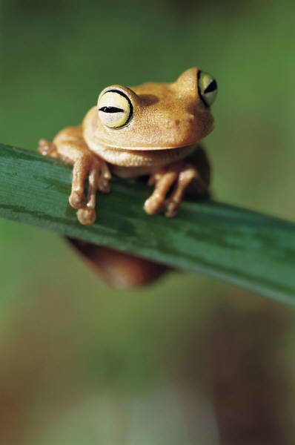
Physical Aspects of the Niche
Part of an organism’s niche involves the abiotic factors it requires for survival.
Example: Most amphibians, for example, lose and absorb water through their skin, so they must live in moist places.
If an area is too hot and dry, or too cold for too long, most amphibians cannot survive.

Slide 6
Biological Aspects of the Niche
Biological aspects of an organism’s niche involve the biotic factors it requires for survival, such as when and how it reproduces, the food it eats, and the way in which it obtains that food.
Example: Birds on Christmas Island in the Indian Ocean, for example, all live in the same habitat but they prey on fish of different sizes and feed in different places.
**Thus, each species occupies a distinct niche.

Slide 7
Competition
How does competition shape communities?
By causing species to divide resources; competition helps determine the number and kinds of species in a community and the niche each species occupies.
How one organism interacts with other organisms is an important part of defining its niche.
Competition occurs when organisms attempt to use the same limited ecological resource in the same place at the same time.

Slide 8
Competition
In a forest, for example, plant roots compete for resources such as water and nutrients in the soil.
Animals compete for resources such as food, mates, and places to live and raise their young.
Competition can occur both between members of the same species (known as intraspecific competition) and between members of different species (known as interspecific competition).

Slide 9
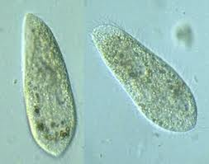
The Competitive Exclusion Principle
Direct competition between different species almost always produces a winner and a loser—and the losing species dies out.
In the the experiment shown in the graph, two species of paramecia (P. aurelia and P. caudatum) were first grown in separate cultures (dashed lines) . In separate cultures, but under the same conditions, both populations grew.
However, when both species were grown together in the same culture (solid line), one species outcompeted the other, and the less competitive species did not survive.

Slide 10
The Competitive Exclusion Principle
The competitive exclusion principle states that no two species can occupy exactly the same niche in exactly the same habitat at exactly the same time.
If two species attempt to occupy the same niche, one species will be better at competing for limited resources and will eventually exclude the other species.
As a result of competitive exclusion, natural communities rarely have niches that overlap significantly.

Slide 11
Predator-Prey Relationships
An interaction in which one animal (the predator) captures and feeds on another animal (the prey) is called predation.
Predators can affect the size of prey populations in a community and determine the places prey can live and feed.
Birds of prey, for example, can play an important role in regulating the population sizes of mice, voles, and other small mammals.
This graph below shows an idealized computer model of changes in predator and prey populations over time.

Slide 12
Symbiosis
Any relationship in which one species lives on, in, or near another species and affects its survival is called symbiosis, which means “living together.”
What are the three primary ways that organisms depend on each other?
Biologists recognize three main classes of symbiotic relationships in nature: mutualism, parasitism, and commensalism.
(from Ancient Greek sýn "with" and bíōsis "living")

Slide 13
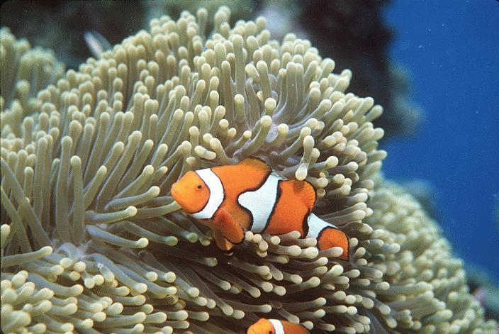
Mutualism
The sea anemone’s sting has two functions: to capture prey and to protect the anemone from predators. Even so, certain fish manage to snack on anemone tentacles.
The clownfish, however, is immune to anemone stings. When threatened by a predator, clownfish seek shelter by snuggling deep into an anemone’s tentacles.
If an anemone-eating species tries to attack the anemone, the clownfish dart out and chase away the predators.
This kind of relationship between species in which both benefit is known as mutualism.

Slide 14
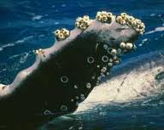
Commensalism
Barnacles often attach themselves to a whale’s skin. They perform no known service to the whale, nor do they harm it. Yet the barnacles benefit from the constant movement of water—that is full of food particles—past the swimming whale.
This is an example of commensalism, a relationship in which one organism benefits and the other is neither helped nor harmed.

Slide 15
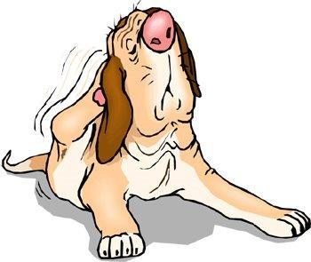
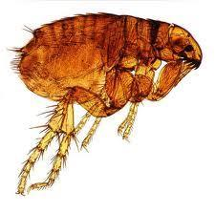
Parasitism
Tapeworms live in the intestines of mammals, where they absorb large amounts of their hosts’ food.
Fleas, ticks, lice, and the leech shown, live on the bodies of mammals and feed on their blood and skin.
These are examples of parasitism, relationships in which one organism lives inside or on another organism and harms it.
The parasite obtains all or part of its nutritional needs from the host organism.
Generally, parasites weaken but do not kill their host, which is usually larger than the parasite.

