Slide 1
Changes in Ecosystems: Ecological Succession

Slide 2
Definition:
Natural, gradual environmental changes in the types of species that live in an area
The gradual replacement of one community by another through natural processes over time
Types: primary or secondary

Slide 3
Primary Succession
Begins in a place without any soil and that was not previously inhabited
Sides of volcanoes
Landslides
Flooding
Starts with the arrival of living things such as lichens that do not need soil to survive
Called PIONEER SPECIES

Slide 4
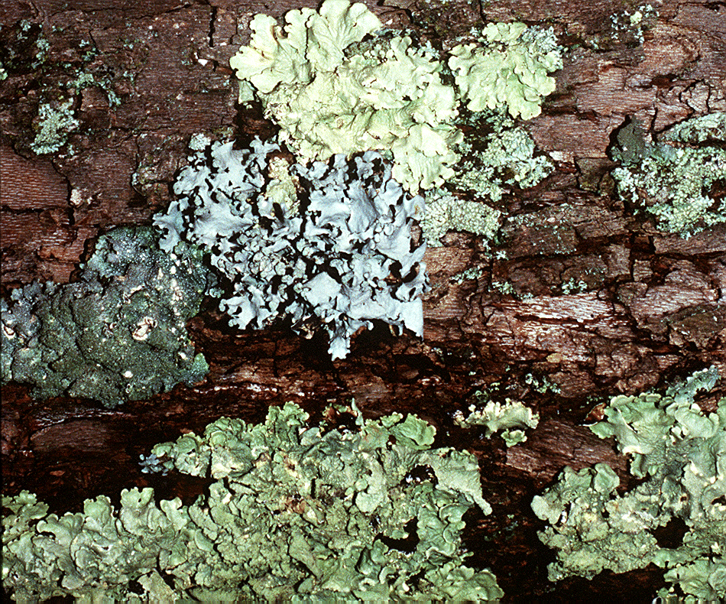
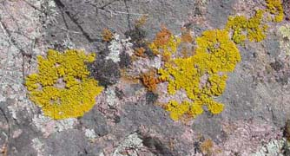
Lichen: mutualistic relationship between fungi and algae
PIONEER SPECIES
http://botit.botany.wisc.edu
Mosses: break rocks into smaller pieces
http://www.saguaro-juniper.com/

Slide 5
Primary Succession
Soil starts to form as lichens and the forces of weather and erosion help break down rocks into smaller pieces
When lichens die, they decompose, adding small amounts of organic matter to the rock to make soil

Slide 6
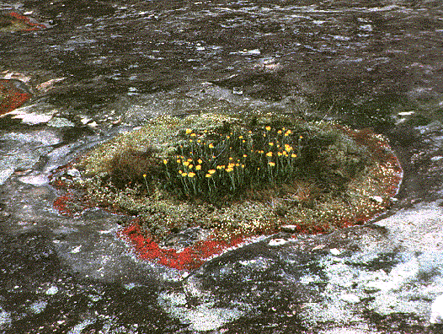
http://www.life.uiuc.edu

Slide 7
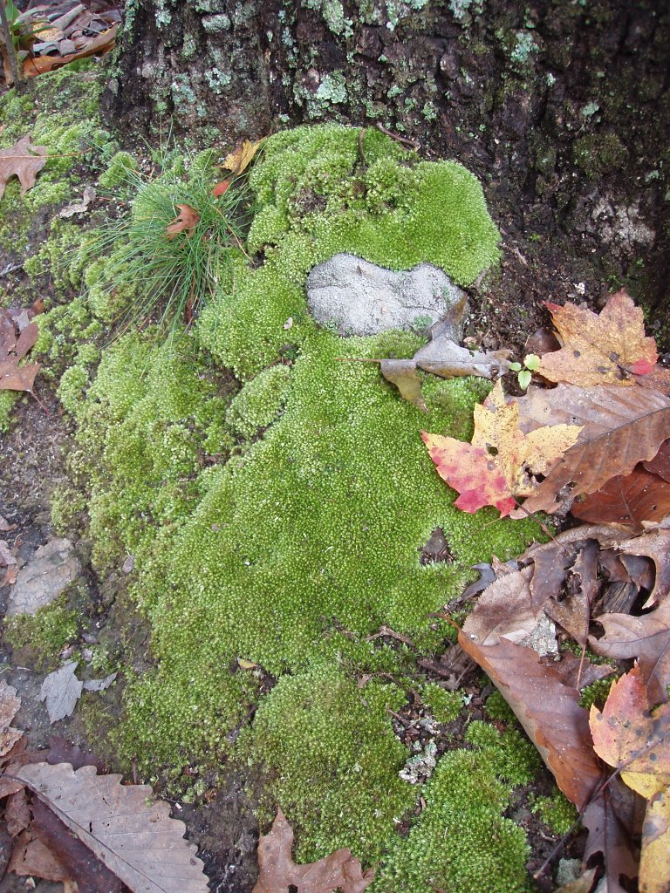
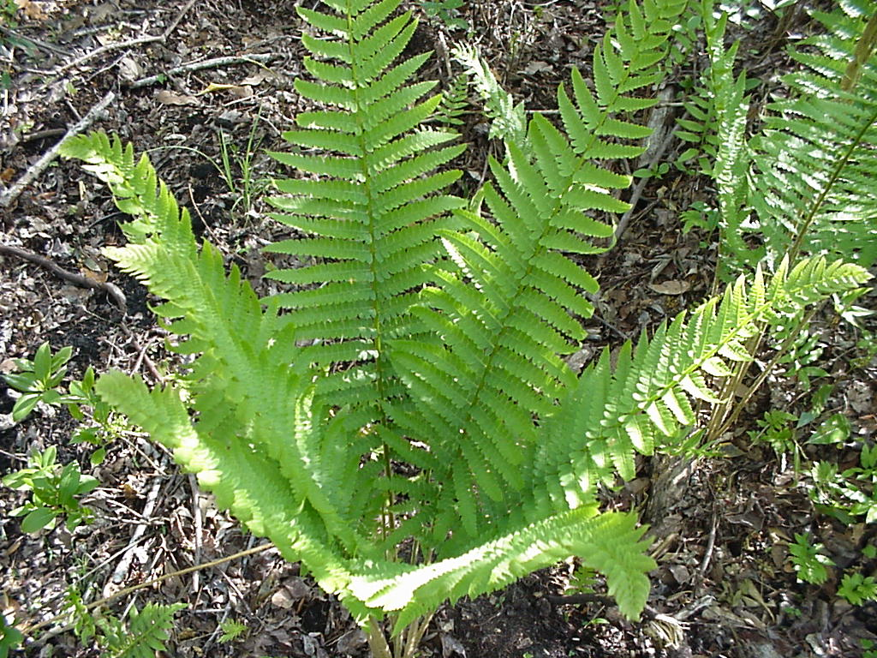
Primary Succession
Simple plants like mosses and ferns can grow in the new soil
http://www.uncw.edu
http://uisstc.georgetown.edu

Slide 8
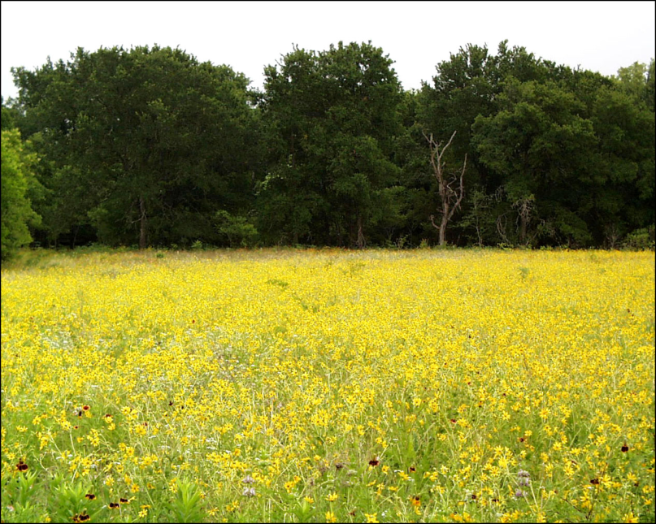
Primary Succession
The simple plants die, adding more organic material
The soil layer thickens, and grasses, wildflowers, and other plants begin to take over
http://www.cwrl.utexas.edu

Slide 9
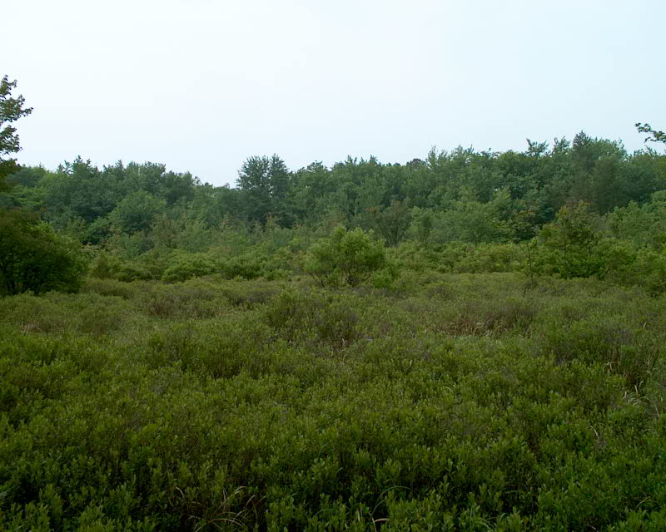
Primary Succession
These plants die, and they add more nutrients to the soil
Shrubs and trees can survive now
http://www.rowan.edu

Slide 10
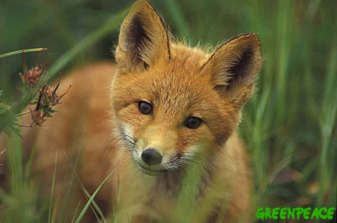
Primary Succession
Insects, small birds, and mammals have begun to move in
What was once bare rock now supports a variety of life
http://p2-raw.greenpeace.org

Slide 11
Secondary Succession
Begins in a place that already has soil and was once the home of living organisms
Examples: after forest fires, vacant lots, clear-cut forest areas, abandoned farmland
Occurs faster and has different pioneer species than primary succession
Ecosystem works to restore original conditions of community

Slide 12
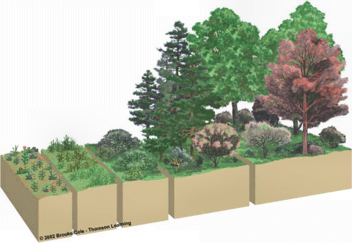
http://www.geo.arizona.edu

Slide 13
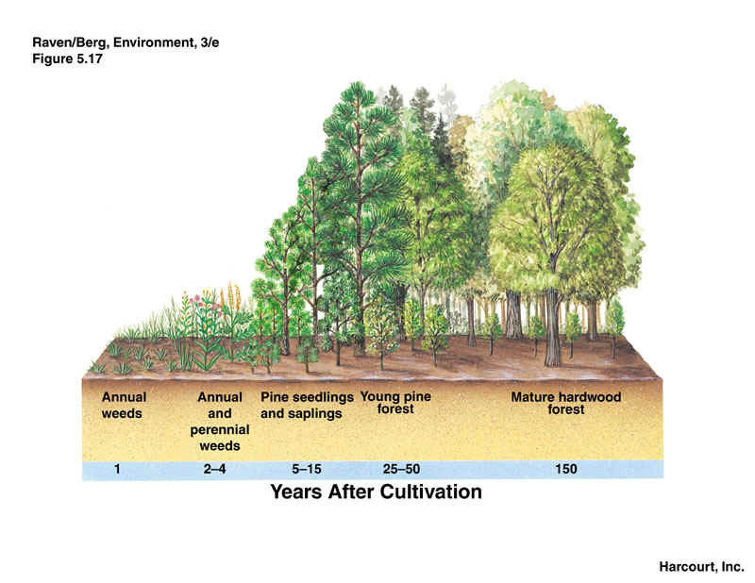
http://www.ux1.eiu.edu

Slide 14
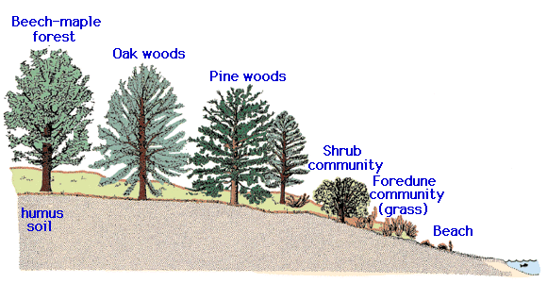
http://www.agen.ufl.edu

Slide 15
Climax Community
A stable group of plants and animals that is the end result of the succession process
Mature community is able to continue its processes as long as there are no disturbances
Limiting factors determines community
Does not always mean big trees
Grasses in prairies
Cacti in deserts

Slide 16
Changes in Ecosystems
The processes of succession are ALWAYS changing ecosystems!!
Some stages may last for a short period of time, others may last for hundreds of years
Any disturbance affects rate of succession
Occurs in ALL ecosystems

