Slide 1
Biogeochemical Cycles
EQ: What are the biogeochemical cycles of nutrients and how are they alike?

Slide 2
Biogeochemical Cycles in Nature
There is only a limited amount of resources (water, nitrogen, carbon) on the Earth.
In order to keep these resources available to organisms, they must be recycled after they are used.
Matter is neither created nor destroyed…it just changes forms.
Biogeochemical Cycles: pathway by which an element or molecule moves through both biotic and abiotic parts of the Earth
Carbon
Water
Nitrogen

Slide 3
Carbon Cycle
Major component of macromolecules
(lipids, proteins, nucleic acids, carbohydrates)
Found in: atmosphere (CO₂), minerals and rocks, fossil fuels, and in organic materials of soil/sediment

Slide 4
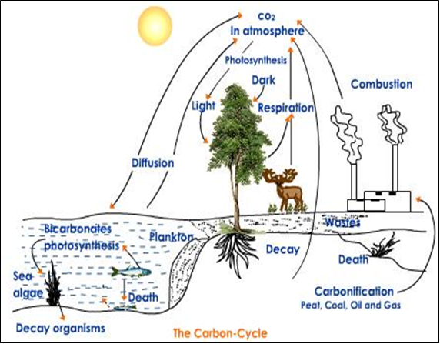
Carbon Cycle
Organisms play a role in recycling carbon through natural, chemical processes…what process?? PHOTOSYNTHESIS!

Slide 5
Water (Hydrologic) Cycle
Water is necessary for life processes of all living organisms
Found in: atmosphere, surface, underground, in living organisms
Driven by energy from the sun.

Slide 6
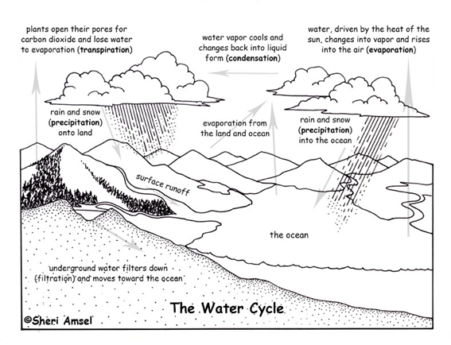
Water (Hydrologic) Cycle
Organisms play a role in recycling water through natural, chemical processes…during what processes?
Precipitation
Condensation
Transpiration
Evaporation
Runoff

Slide 7
Nitrogen Cycle
Nitrogen is component of amino acids - build proteins.
Found in: atmosphere (N₂), living organisms (proteins & nucleic acids), soil/sediment
Key Steps:
1. Nitrogen fixation: Bacteria in the roots of plants (called
legumes) change Nitrogen from the atmosphere (N₂) to different Nitrogen
compounds (NO₃)
2. Plants absorb the Nitrogen
3. Animals eat the plants - take in Nitrogen
4. Decay/Decomposition – Organisms die or leave behind
wastes (bacteria digest the Nitrogen)
5. Denitrification: Bacteria change the NO₃ back to N₂ and release it to the atmosphere

Slide 8
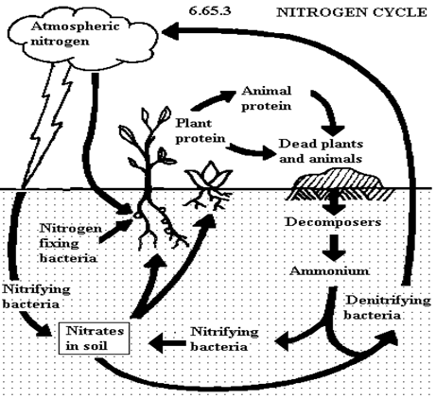
Nitrogen Cycle
Organisms play a role in recycling nitrogen through natural, chemical processes… Nitrogen fixation and denitrification

